Slide 1
Computer Networks Security
Alex Carp
carpalex@gmail.com
12.04.2025

Slide 2
Agenda
Firewalls – a brief history
Next generation firewalls – main features
Lab topology
Demo
Home assignment

Slide 3
Firewalls
What is a firewall?
1st generation
a.k.a “packet-filtering” firewalls
2nd generation
a.k.a “stateful” firewalls
3rd generation
a.k.a “next generation” firewalls

Slide 4
Packet-filtering firewalls
Only able to inspect each packet, in isolation
Can look at:
Source IP
Destination IP
Source port
Destination port
Does NOT understand transport (TCP/UDP) session logic

Slide 5


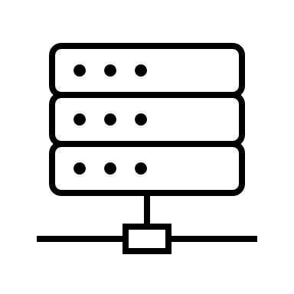
Packet-filtering firewalls - example
Client
10.0.0.1
Firewall
Web Server
150.1.2.3:80
Firewall rule(s):
ip src 10.0.0.1 ip dst 150.1.2.3 port dst 80 allow
ip src 150.1.2.3 ip dst 10.0.0.1 port src 80 allow

Slide 6

Packet-filtering firewalls - problems
ip src: 150.1.2.3
ip dst: 10.0.0.1
port src: 80
Client
10.0.0.1
Firewall
Web Server
150.1.2.3:80
Firewall rule(s):
ip src 10.0.0.1 ip dst 150.1.2.3 port dst 80 allow
ip src 150.1.2.3 port src 80 ip dst 10.0.0.1 allow

Slide 7
Stateful firewalls
Are able to understand transport-layer logic (TCP/UDP)
Can decide if a session is:
New
Established
Closed
Illegitimate
Decisions are taken per session, NOT per packet

Slide 8
Stateful firewalls - example
Client
10.0.0.1
Firewall
Web Server
150.1.2.3:80
Firewall rule(s):
- ip src 10.0.0.1 ip dst 150.1.2.3 port dst 80 allow

Slide 9
Next-generation firewalls
Main features
App ID
Content ID
User ID
Zone-based policy

Slide 10
Next-generation firewall – App ID
Client
10.0.0.1
Firewall
Web Server
150.1.2.3 :80, :8081
Firewall rule(s):
ip src 10.0.0.1 ip dst 150.1.2.3 port dst 80 allow
ip src 10.0.0.1 ip dst 150.1.2.3 port dst 8081 allow
ip src 10.0.0.1 ip dst 150.1.2.3 app http allow

Slide 11
Next-generation firewalls – Content ID
Ability to differentiate between benign and malicious payloads
Viruses
Exploits
Spyware

Slide 12
Next-generation firewalls – User ID
Client
10.0.0.1
192.168.1.2
Firewall
Web Server
150.1.2.3:80
Firewall rule(s):
ip src 10.0.0.1 ip dst 150.1.2.3 port dst 80 allow
ip src 192.168.1.2 ip dst 150.1.2.3 port dst 80 allow
user src student ip dst 150.1.2.3 port dst 80 allow

Slide 13
Next-generation firewalls – ZBP
private
public
Client
10.0.0.1
192.168.1.2
Firewall
Web Server
150.1.2.3:80
Firewall rule(s):
- user src student zone src private zone dst public app http allow

Slide 14
Next-generation firewalls
Types
physical appliance
virtual appliance
Topologies
transparent
routed

Slide 15

Next-generation firewalls – virtual wire
Client
10.0.0.1
Firewall
(transparent)
Web Server
10.0.0.2

Slide 16
Next-generation firewalls – virtual router
10.0.0.254
150.1.2.254
Client
10.0.0.1
Firewall
(router)
Web Server
150.1.2.3

Slide 17
Topology and Demo

Slide 18
Home assignment
Solve all the tasks (00 – > 08) on your own setup
Deliverables:
PAN config XML, saved after solving task 06
PAN config XML, saved after solving task 08
Send the 2 XML files to: carpalex@gmail.com
Deadline: 27.04.2025 / 23:59:59
Lab resources: https://ctipub-my.sharepoint.com/:f:/g/personal/alexandru_carp_upb_ro/Ek-Hs5NNOjFOhs627c9MgIkBRnKQwxrgJpsk3Q5Ji_utUA?e=vGtFbQ
No lab on 13.04.2025

